Slide 1
How does the continuous addition of new traits affect U.S. selection indices?
John B. Cole,^{1,2,3,4}
¹Council on Dairy Cattle Breeding
²Department of Animal Sciences, University of Florida
³Department of Animal Science, North Carolina State University
⁴Centre for Genetic Improvement of Livestock, Department of Animal Biosciences, University
of Guelph

Slide 2
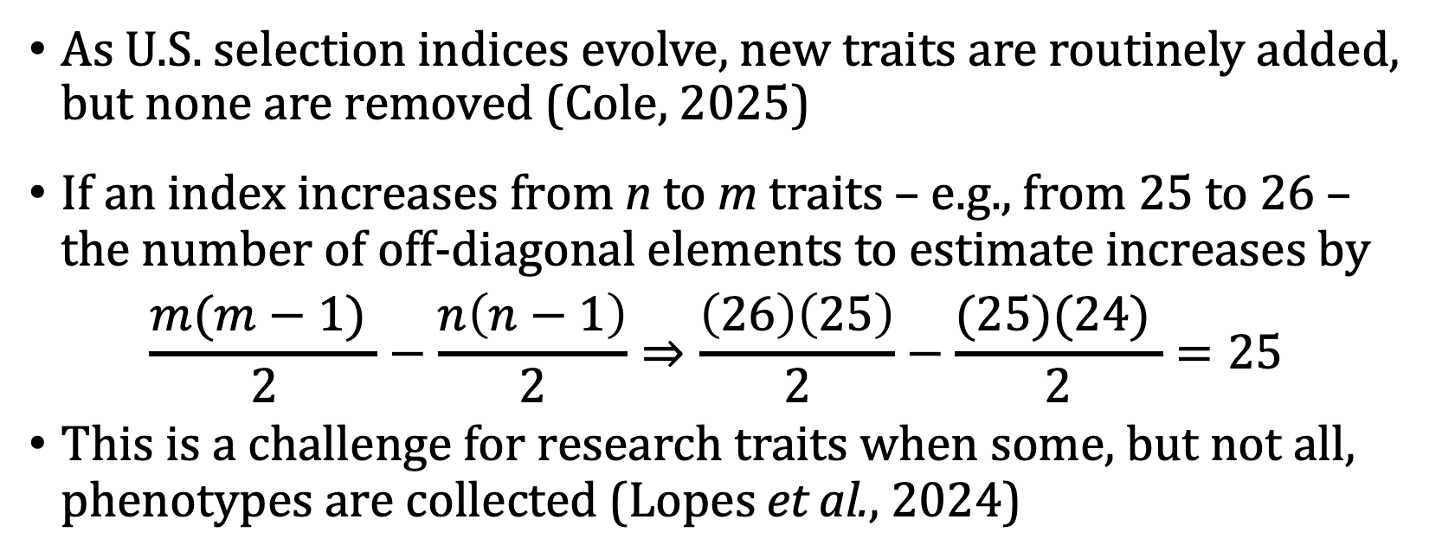
Background
As U.S. selection indices evolve, new traits are routinely added, but none are removed (Cole, 2025)
If an index increases from n to m traits – e.g., from 25 to 26 – the number of off-diagonal elements to estimate increases by
$$\frac{m(m−1) }{2}−\frac{n\left(n−1\right)}{2}⇒\frac{\left(26\right)\left(25\right)}{2}−\frac{(25)(24) }{2}=25$$
This is a challenge for research traits when some, but not all, phenotypes are collected (Lopes et al., 2024)

Slide 3
Traits Included | PD$ (1971) | MFP$ (1976) | NM$ (1994) | NM$ (2000) | NM$ (2003) | NM$ (2006) | NM$ (2010) | NM$ (2014) | NM$ (2017) | NM$ (2018) | NM$ (2021) | NM$ (2025)
Milk | 52 | 27 | 6 | 5 | 0 | 0 | 0 | -1 | -1 | -1 | 0 | 3
Fat | 48 | 46 | 25 | 21 | 22 | 23 | 19 | 22 | 24 | 27 | 22 | 25
Protein |  | 27 | 43 | 36 | 33 | 23 | 16 | 20 | 18 | 17 | 17 | 11
Productive Life |  |  | 20 | 14 | 11 | 17 | 22 | 19 | 13 | 12 | 15 | 12
Somatic Cell Score |  |  | -6 | -9 | -9 | -9 | -10 | -7 | -7 | -4 | -3 | -3
Body Weight Composite |  |  |  | -4 | -3 | -4 | -6 | -5 | -6 | -5 | -9 | -11
Udder Composite |  |  |  | 7 | 7 | 6 | 7 | 8 | 7 | 7 | 3 | 1
Foot & Leg Composite |  |  |  | 4 | 4 | 3 | 4 | 3 | 3 | 3 | 1 | 1
Daughter Pregnancy Rate |  |  |  |  | 7 | 9 | 11 | 7 | 7 | 7 | 5 | 3
Calving Ability $ |  |  |  |  |  | 6 | 5 | 5 | 5 | 5 | 3 | 3
Heifer Conception Rate |  |  |  |  |  |  |  | 1 | 1 | 1 | 1 | 1
Cow Conception Rate |  |  |  |  |  |  |  | 2 | 2 | 2 | 1 | 2
Livability |  |  |  |  |  |  |  |  | 7 | 7 | 4 | 6
Health $ |  |  |  |  |  |  |  |  |  | 2 | 2 | 2
Residual Feed Intake |  |  |  |  |  |  |  |  |  |  | -12 | -14
Early First Calving |  |  |  |  |  |  |  |  |  |  | 1 | 1
Heifer Livability |  |  |  |  |  |  |  |  |  |  | 1 | 1

Slide 4
Example: Adding methane to Net Merit $
Adding 1 new trait requires 25 new correlation estimates
26 traits and composites ⇒
325 correlations to estimate!
25 traits and composites ⇒
300 correlations to estimate!
(new correlations)

Slide 5
Objective
Selection indices are commonly said to be robust to errors in parameter estimates (e.g., Cole and VanRaden, 2017)
Different than the n << p problem in bioinformatics (e.g., Schäfer and Strimmer, 2005)
Sivanadian and Smith (1997) recommend emphasis should be placed on new traits with high heritabilities when parameter estimates are poor
The goal of this study is to explore the robustness of selection indices to errors or misspecification of relationships among traits

Slide 6
Scenarios
Early First Calving (EFC), Heifer Livability (HLV), and Residual Feed Intake (RFI) were proxies for traits such as methane or water intake
Scenario 1
Assumed published G and P matrices are correct
Scenario 2
Randomly permuted off-diagonal elements of G and P for EFC and HLV
Scenario 3
Randomly changed signs of off-diagonal elements of G and P (25%, 50%, and 75% of values)
Scenario 4
Off-diagonal elements of G and P were set to zero (25%, 50%, and 75% of values)
Scenarios were replicated 1,000× and the same seed was used within replicate for consistent permutation

Slide 7
Scenario 1
No changes
Scenario 2
Permutation
Scenario 3
Signs changed
Scenario 4
Set to zero
1
2 | 3
4 | 5 | 6
1
3 | 5
6 | 2 | 4
1
-2 | 3
4 | -5 | -6
1
0 | 3
4 | 0 | 0
(25%, 50%, 75%)
(25%, 50%, 75%)
Calculate responses to selection using new correlation matrices

Slide 8
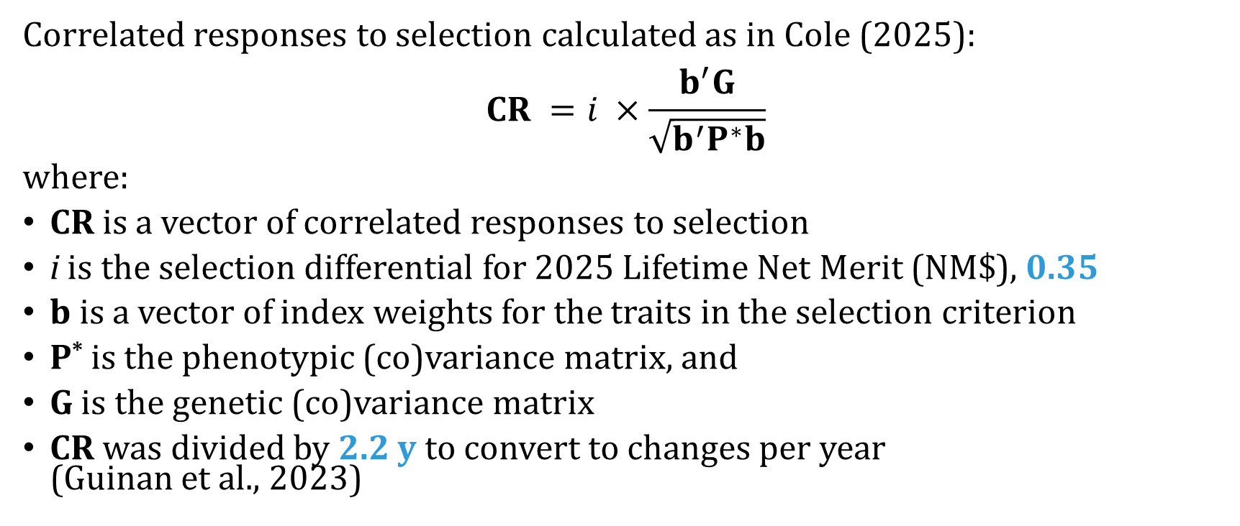
Selection response
Correlated responses to selection calculated as in Cole (2025):
$$CR =i ×\frac{b^{′}G}{\sqrt{b^{′}P^{∗}b}}$$
where:
CR is a vector of correlated responses to selection
i is the selection differential for 2025 Lifetime Net Merit (NM$), 0.35
b is a vector of index weights for the traits in the selection criterion
P* is the phenotypic (co)variance matrix, and
G is the genetic (co)variance matrix
CR was divided by 2.2 y to convert to changes per year
(Guinan et al., 2023)

Slide 9
Results
Shuffling (co)variances often produced larger differences than changing signs or setting values to zero, regardless of the proportion of values affected
When values are permuted, the magnitude of (co)variances among traits is affected, which is not necessarily the case in other scenarios
Larger effects on yield traits might be expected for EFC/HLV because of higher genetic correlations (0.168–0.398), but phenotypic correlations are much smaller (0.009–0.020)

Slide 10
Early First Calving (h² = 0.027) & Heifer Livability (h² = 0.007)
Trait | Scenario 1 |  | Scenario 2 |  | Scenario 3 |  |  |  | Scenario 4
 | NM$2025 |  | Random |  | 25 | 50 | 75 |  | 25 | 50 | 75
Milk | 51.7170 |  | 52.9617 |  | 50.7586 | 50.7587 | 50.7575 |  | 50.7601 | 50.7596 | 50.7586
Fat | 2.9148 |  | 3.0959 |  | 2.8918 | 2.8918 | 2.8918 |  | 2.8919 | 2.8918 | 2.8918
Protein | 1.7188 |  | 1.8576 |  | 1.6941 | 1.6941 | 1.6941 |  | 1.6941 | 1.6942 | 1.6942
PL | 0.2213 |  | 0.3117 |  | 0.2169 | 0.2169 | 0.2169 |  | 0.2169 | 0.2169 | 0.2169
SCS | -0.0031 |  | 0.0960 |  | -0.0030 | -0.0030 | -0.0030 |  | -0.0030 | -0.0030 | -0.0030
UDC | -0.0010 |  | 0.0874 |  | -0.0010 | -0.0010 | -0.0010 |  | -0.0010 | -0.0010 | -0.0010
FLC | -0.0096 |  | 0.0797 |  | -0.0095 | -0.0095 | -0.0095 |  | -0.0095 | -0.0095 | -0.0095
BWC | -0.0722 |  | 0.0129 |  | -0.0726 | -0.0726 | -0.0726 |  | -0.0726 | -0.0726 | -0.0726
DPR | 0.0421 |  | 0.1253 |  | 0.0389 | 0.0389 | 0.0389 |  | 0.0389 | 0.0389 | 0.0389
CA$ | 1.1842 |  | 1.3027 |  | 1.1590 | 1.1590 | 1.1590 |  | 1.1590 | 1.1591 | 1.1591
HCR | 0.0578 |  | 0.1431 |  | 0.0540 | 0.0540 | 0.0540 |  | 0.0540 | 0.0540 | 0.0540
CCR | 0.1201 |  | 0.2025 |  | 0.1154 | 0.1154 | 0.1154 |  | 0.1154 | 0.1154 | 0.1154
LIV | 0.1237 |  | 0.2123 |  | 0.1215 | 0.1215 | 0.1215 |  | 0.1215 | 0.1215 | 0.1215
GL | -0.0584 |  | 0.0349 |  | -0.0566 | -0.0566 | -0.0566 |  | -0.0566 | -0.0566 | -0.0566
HTH$ | 0.7334 |  | 0.8612 |  | 0.7185 | 0.7185 | 0.7185 |  | 0.7185 | 0.7185 | 0.7185
RFI | -12.1145 |  | -12.6710 |  | -12.1654 | -12.1654 | -12.1654 |  | -12.1654 | -12.1654 | -12.1654
MFEV | 0.0028 |  | 0.0029 |  | 0.0028 | 0.0028 | 0.0028 |  | 0.0028 | 0.0028 | 0.0028
DSAB | 0.0350 |  | 0.0366 |  | 0.0351 | 0.0351 | 0.0351 |  | 0.0351 | 0.0351 | 0.0351
KETO | 0.0337 |  | 0.0353 |  | 0.0339 | 0.0339 | 0.0339 |  | 0.0339 | 0.0339 | 0.0339
MAST | 0.0337 |  | 0.0352 |  | 0.0338 | 0.0338 | 0.0338 |  | 0.0338 | 0.0338 | 0.0338
METR | 0.0472 |  | 0.0494 |  | 0.0474 | 0.0474 | 0.0474 |  | 0.0474 | 0.0474 | 0.0474
REPL | 0.0064 |  | 0.0067 |  | 0.0065 | 0.0065 | 0.0065 |  | 0.0065 | 0.0065 | 0.0065
EFC | 0.1494 |  | -1.2560 |  | 0.0105 | 0.0106 | 0.0105 |  | 0.0110 | 0.0106 | 0.0106
HLV | 0.0460 |  | -0.2618 |  | 0.0063 | 0.0063 | 0.0063 |  | 0.0065 | 0.0064 | 0.0063

Slide 11
Residual Feed Intake (h² = 0.14)
Trait | Scenario 1 |  | Scenario 2 |  | Scenario 3 |  |  |  | Scenario 4
 | NM$2025 |  | Random |  | 25 | 50 | 75 |  | 25 | 50 | 75
Milk | 51.7170 |  | 51.5006 |  | 51.4598 | 51.4598 | 51.4598 |  | 51.4510 | 51.7170 | 51.7170
Fat | 2.9148 |  | 2.9011 |  | 2.8909 | 2.8909 | 2.8909 |  | 2.8909 | 2.9148 | 2.9148
Protein | 1.7188 |  | 1.7557 |  | 1.7146 | 1.7146 | 1.7146 |  | 1.7189 | 1.7146 | 1.7146
PL | 0.2213 |  | 0.2238 |  | 0.2136 | 0.2136 | 0.2136 |  | 0.2213 | 0.2136 | 0.2136
SCS | -0.0031 |  | 0.0060 |  | -0.0042 | -0.0042 | -0.0042 |  | -0.0031 | -0.0042 | -0.0042
UDC | -0.0010 |  | 0.0391 |  | -0.0017 | -0.0017 | -0.0017 |  | -0.0010 | -0.0017 | -0.0017
FLC | -0.0096 |  | -0.0037 |  | -0.0139 | -0.0139 | -0.0139 |  | -0.0096 | -0.0139 | -0.0139
BWC | -0.0722 |  | -0.0551 |  | -0.0654 | -0.0654 | -0.0654 |  | -0.0722 | -0.0654 | -0.0654
DPR | 0.0421 |  | 0.0926 |  | 0.0515 | 0.0515 | 0.0515 |  | 0.0421 | 0.0515 | 0.0515
CA$ | 1.1842 |  | 1.1220 |  | 1.1118 | 1.1118 | 1.1118 |  | 1.1842 | 1.1842 | 1.1118
HCR | 0.0578 |  | 0.1005 |  | 0.0595 | 0.0595 | 0.0595 |  | 0.0578 | 0.0578 | 0.0595
CCR | 0.1201 |  | 0.1663 |  | 0.1253 | 0.1253 | 0.1253 |  | 0.1253 | 0.1201 | 0.1201
LIV | 0.1237 |  | 0.1270 |  | 0.1168 | 0.1168 | 0.1168 |  | 0.1237 | 0.1168 | 0.1168
GL | -0.0584 |  | -0.0465 |  | -0.0567 | -0.0567 | -0.0567 |  | -0.0584 | -0.0584 | -0.0567
HTH$ | 0.7334 |  | 0.7595 |  | 0.7493 | 0.7493 | 0.7493 |  | 0.7334 | 0.7334 | 0.7493
RFI | -12.1145 |  | -5.2059 |  | -9.8789 | -9.8789 | -9.8789 |  | -10.7731 | -11.8592 | -11.2209
MFEV | 0.0028 |  | 0.0021 |  | 0.0032 | 0.0032 | 0.0033 |  | 0.0028 | 0.0032 | 0.0032
DSAB | 0.0350 |  | 0.0317 |  | 0.0329 | 0.0329 | 0.0329 |  | 0.0329 | 0.0350 | 0.0350
KETO | 0.0337 |  | 0.0326 |  | 0.0337 | 0.0337 | 0.0337 |  | 0.0337 | 0.0337 | 0.0337
MAST | 0.0337 |  | 0.0379 |  | 0.0391 | 0.0391 | 0.0391 |  | 0.0337 | 0.0391 | 0.0391
METR | 0.0472 |  | 0.0481 |  | 0.0492 | 0.0492 | 0.0492 |  | 0.0472 | 0.0472 | 0.0492
REPL | 0.0064 |  | 0.0066 |  | 0.0077 | 0.0077 | 0.0077 |  | 0.0064 | 0.0077 | 0.0077
EFC | 0.1494 |  | 0.1493 |  | 0.1504 | 0.1504 | 0.1504 |  | 0.1494 | 0.1504 | 0.1504
HLV | 0.0460 |  | 0.0460 |  | 0.0460 | 0.0460 | 0.0460 |  | 0.0460 | 0.0460 | 0.0460

Slide 12
Conclusions
Responses to index selection were robust to errors in (co)variances, including random permutation of values, incorrect signs, and values erroneously set to zero
These results may not hold in the face of systematic errors, which were not modeled
The addition of new traits to selection indices is unlikely to substantially affect rates of gain for other traits in those indices
Preliminary or incomplete information from research traits may be included in selection indices without undue concern

Slide 13
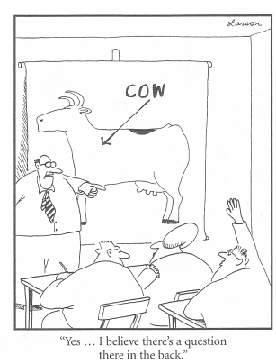
Questions?
Thank you for your attention!
john.cole@uscdcb.com

